Slide 1


Strengthening Security at TeamViewer to Mitigate Advanced Threats

Slide 2
Agenda
Introduction
Recommendation
Implementation
Financials
Risks and Mitigation
Conclusion
Introduction

Slide 3




Meet the Team
Shane Rodriguez
Garrett Williams
Jong Won Choi
Anirban Das
Introduction

Slide 4

Identifying and Solving Key Security Challenges from the TeamViewer Breach
In June 2024, TeamViewer’s monitoring system detected unauthorized access within its corporate IT environment, attributed to the state-sponsored hacking group APT29. The breach was contained before impacting customer data, but it exposed vulnerabilities in current credential management and detection measures
APT29’s sophisticated tactics exploited gaps in TeamViewer’s security protocols. The incident underscores the limitations of traditional security measures and highlights a pressing need for more robust defenses to safeguard sensitive systems and data
How can TeamViewer strengthen its security framework to prevent, detect, and respond to advanced cyber threats, ensuring future resilience against sophisticated actors like APT29?
Introduction

Slide 5

Who Is APT29 and How Did They Affect TeamViewer?
Spear-Phishing at TeamViewer
Limited Scope of Compromise The breach affected only TeamViewer's internal corporate environment and a single employee account A broader compromise was avoided, suggesting a targeted phishing attack rather than a brute-force or exploit-based approach
Advanced Persistent Threat (APT) 29
Targeted Credentials Compromise Only one employee account was compromised, pointing to legitimate credential theft The attack's precision is consistent with phishing, targeting specific users to steal credentials
Hacker groups believed to be linked to the Russian Foreign Intelligence Service (SVR)
APT 29's Tactics and Techniques APT 29’s recent campaign involved phishing emails exploiting RDP access The subtle, targeted attack suggests a well-orchestrated phishing campaign aimed at exploiting human weaknesses
Introduction

Slide 6




Identifying the Root Cause Behind APT29’s Spear Phishing Attack
Lack of Employee Training Employees were insufficiently trained to recognize sophisticated phishing attacks Phishing emails and attachments from external sources were not adequately flagged or avoided
Deficiencies in MFA and Preventive Measures Multi-Factor Authentication (MFA) was not sufficiently implemented across all access points Preventive measures were inadequate to prevent unauthorized access
Failure to Adhere to Least Privilege Principles A single employee account compromise led to broader access to internal credentials The absence of a strict privilege policy allowed unnecessarily broader access
Lack of Detective Behavior Monitoring No comprehensive analysis of user behavior or daily patterns to identify and flag anomalies Absence of proactive monitoring limited the detection of suspicious activities
Recommendations

Slide 7
Implement Training and Security Layers to Address Root Causes
Employee Training
Increased Email Monitoring
Web Filtering
Employee training using SANS Security Awareness should consist of 1-2 hours of modular training on key topics like phishing, secure browsing, and incident reporting
This training should be reinforced with quarterly refreshers, post-incident sessions, and regular simulated phishing exercises to assess and improve employee vigilance
For blocking suspicious emails, advanced email security tools (like Zscaler) should be deployed to scan for and block suspicious attachments, links, and emails from known malicious domains
Emails that are flagged but not blocked should be marked with warning banners to prompt employees to exercise caution with potentially harmful content
Web filtering and DNS security can be implemented by using DNS filtering to block known malicious domains, thereby protecting users even if they click on a phishing link
Real-time link analysis tools can further enhance security by verifying URLs upon click, dynamically preventing access to unsafe sites
Training Programs + Frameworks
SANS Security Awareness Training and MITRE ATT&CK: Masquerading and Domain Authentication
Recommendations

Slide 8
Advanced Authentication Technology Can Reinforce the Current MFA Process
Current Challenges with Existing MFA
Advanced Cryptographic Authentication
Interception of One-Time Codes (OTP) Current MFA methods rely on OTP sent via out-of-band communications. These codes are vulnerable to interception if an adversary gains access to the communication channel or compromises the service provider
Phishing-Resistant Authentication Requiring a registered, physical security device eliminate the reliance on OTP Attacks on service providers are ineffective
Push Notification Attacks and MFA Fatigue Push-based MFA can be exploited through repetitive login attempts, bombarding users with notifications which lead to “MFA fatigue” where users mistakenly approve unauthorized requests due to excessive prompts
No Push Notification Vulnerabilities Users will not receive unsolicited prompts Users can avoid the risks of mistakenly approving unauthorized access attempts
Keylogger Vulnerability Current MFA require users to enter a static PIN along with their smart card and if keylogger is present on the device, and attacker can capture the password entered by the user
Challenge-Response Protocols There is no need for static PIN or password Keylogger can't capture reusable credentials
Recommendations

Slide 9
Implementing Least Privileges and Role Based Access Controls for an Additional Layer of Protection
Role-Based Access Control (RBAC)
Establish specific access levels based on job functions, ensuring each role only has permissions necessary for its responsibilities
Conduct regular audits of access roles to align with evolving job requirements, reducing permission creep over time
High-Risk Data Segmentation
Isolate high-risk data from general access by implementing network segmentation, limiting access to sensitive information
Multi-Approval for Privileged Access
Limit access to critical data strictly to personnel who need it, minimizing potential exposure in case of a breach
For accessing high-risk resources, mandate dual approval to add an additional layer of security and oversight
Deploy PAWs for administrative functions to separate privileged actions from routine tasks, reducing phishing-related risks
Reduce Attack Surface
T1078 (Valid Accounts)
Mitigate Insider Threats
T1021 (Remote Services)
Reduce Attack Surface
T1055 (Process Injection)
Recommendations

Slide 10
Enhancing Detective Behavior Monitoring through a Multi-Layered Security Strategy
Implement NIST Cybersecurity Framework
Incident Alerting and Reporting for Real-Time Threat Response
Utilize Advanced Detection & Centralized Event Management
Identify: Track and manage all assets, including endpoints Protect: Enforce secure access and configurations
Detect: Continuously monitor for unusual activity across environments
Respond: Correlate events and address vulnerabilities swiftly
Recover: Test recovery plans to quickly restore systems and data
Behavioral Baselines for Anomaly Detection: Use User and Entity Behavior Analytics (UEBA) to establish baselines of normal user behavior and detect deviations
Dashboard for Incident Visibility: Implement a central dashboard to visualize incident trends and provide actionable insights to both security teams and organizational leadership
Centralized SIEM Platform: Use a centralized SIEM platform to aggregate and analyze logs from all environments in a centralized SIEM
Threat Intelligence Integration: Incorporate threat intelligence feeds into the SIEM, enhancing detection capabilities by identifying known malicious indicators such as IPs or file hashes linked to threat actors
This security strategy builds a layered defense, beginning with NIST foundational controls, enhancing proactive alerting and reporting, and culminating in advanced detection and centralized event management to create a multi-tiered barrier against sophisticated threats
Recommendations

Slide 11
Project Completion will be in 8 Months with Training and Continuous Monitoring Following
 | Months
Steps | 1 | 2 | 3 | 4 | 5 | 6 | 7 | 8 | 9 | 10 | 11 | 12
Stakeholder Buy-In
Risk Assessment
Vendor Selection & Procurement
Deploy SIEM and Threat Intelligence Feeds
Setup RBAC, PAWs, and MFA
Launch Employee Training Program
Simulated Phishing Campaigns
Continuous Monitoring
Performance and Security Audit
Implementation

Slide 12
Strengthening Security Measures with Strategic Investment
Cost and Benefit Breakdown
Total one-time costs: $860,000 Total recurring costs: $1,800,000 Total costs: $2,660,000 Year 1 benefits: $1,111,000 Year 2 benefits: $1,111,000 Year 3 benefits: $1,111,000 Total benefits: $3,333,000
Key Assumptions
20% lower chance of security breach Security breach avoidance accounted for every year 3 Year projection to show break-even WACC is 9.49% (Software industry Std.)
NPV= $407,576 ROI = 24% B/E: Year 2
Financials

Slide 13


Possible Risks will be Mitigated with a Solid Defense Strategy
Risk | Degree | Mitigation Strategy
Over-Reliance on Employee Training |  | Ensure Phishing Simulations are promoted along with employee training. Safeguard layers will be used to detect security attacks that pass-through employee training initiatives
Privileged Access Abuse or Misuse |  | Streamline the approval process for accessing sensitive resources by automating role-based access control (RBAC) workflows, ensuring quick and efficient access for approved users while enforcing compliance
Insufficient Monitoring Capabilities with SIEM |  | Integrate threat intelligence feeds from reputable sources into the SIEM for enhanced detection capabilities. Additionally, implement regular tuning of SIEM rules and thresholds based on new threat intelligence to ensure effective anomaly detection
Severity
Probability
Severity
Probability
Severity
Probability
Risks & Mitigation
Notes:
Anirban

Slide 14




Implementing a Comprehensive Security Framework for Long-Term Resilience
Address Root Causes
Equip employees with targeted security training and regular phishing simulations to build awareness and make them a proactive part of your defense
Add Layered Protection
Strengthen entry points with strong MFA and advanced email filtering, creating multiple security layers. This approach not only blocks unauthorized access but also safeguards your system in case one layer is compromised
Enforce Least Privilege
Limit access to sensitive information based on roles, ensuring that only essential personnel have access. This minimizes internal risks and ensures critical data is protected from unnecessary exposure
Proactive Monitoring
Implement real-time monitoring to detect and respond to unusual activities quickly. Early detection enables rapid action, containing threats and reducing potential damage
Conclusion

Slide 15
Appendices
Case Assumptions
SANS Security and MITRE
Financial Assumptions
Financial Calculations
Extended Risks
Issue Tree
Sources

Slide 16
TeamViewer Case Assumptions
Assumption: APT29 used a Spear Phishing attack through email to compromise an employee account. We are assuming this because most related incidents involving this group have been through this method. Source: APT29 Spearphishing Campaign Targets Thousands with RDP Files - Infosecurity Magazine
Assumption: TeamViewer currently has multifactor authentication with push notification abilities but not password confirmation to authenticate. We are assuming that this needs to be hardened for effective use.
Assumption: The employee account that was hacked was a standard analyst or senior analyst and not an executive employee. This connects with our recommendation for least privileges.
Assumption: There is least privileges currently set up, but it is not standardized or followed completely as shown in the case.

Slide 17
SANS Security Awareness Training and MITRE ATT&CK: Masquerading and Domain Authentication
MITRE ATT&CK Domain Authentication
“Train users to recognize and handle suspicious email attachments. Emphasize the importance of caution when opening attachments from unknown or unexpected sources, even if they appear legitimate. Implement email warning banners to alert users about emails originating from outside the organization or containing attachments, reinforcing awareness and helping users identify potential spear phishing attempts.”
SANS Security Awareness Training
“SANS is the most trusted and largest source for information security awareness training and security certification in the world. Leverage our best-in-class Security Awareness solutions to transform your organization’s ability to measure and manage human risk.”
MITRE ATT&CK Masquerading
“Train users not to open email attachments or click unknown links (URLs). Such training fosters more secure habits within your organization and will limit many of the risks.”

Slide 18
Financial Assumptions
A 2024 analysis by CanIPhish estimates SANS security awareness training at about $2 per employee per month. For 1,500 employees, this would total roughly $36,000 annually
A 2024 estimate from ITQlick suggests Zscaler pricing at around $2.40 per user per month, totaling roughly $43,200 annually for 1,500 employees. (itqlick.com)
Potential Savings: Implementing security awareness training and advanced security measures can reduce the likelihood and impact of breaches. Even a 10% reduction equates to approximately $488,000 in savings.
Potential Savings: By preventing incidents, employees remain productive. If a breach causes a 1% productivity loss across 1,000 employees with an average salary of $70,000, the annual savings from prevention would be around $700,000.
Provide YubiKey 5C NFC to 1200 employees who are not managers and do not require access to sensitive information. Other 300 managers or those who need higher level of access will receive YubiKey C Bio Buy YubiKeys at Yubico.com | Shop hardware authentication security keys
Deploying a secure cryptographic authentication infrastructure requires investment in compatible servers and potentially upgrading existing legacy systems What Is FIDO2 & How Does FIDO Authentication Work?
Annual costs for support contracts, maintenance of servers, and software updates related to the cryptographic infrastructure; 10–15% of the initial setup cost Cost of Multi-Factor Authentication: Is It Worth the Price? - 1Kosmos
Replacing lost or damaged tokens and managing inventory (e.g., for employees leaving or joining); 5–10% of the initial token purchase annually Cost of Multi-Factor Authentication: Is It Worth the Price? - 1Kosmos
FIDO2 compatibility upgrade would cost $250,000
SIEM software’s initial cost would be $200,000
TeamViewer handle maximum 300GB of logs per day
Salary: Cyber Security Auditor (Nov, 2024) United States

Slide 19
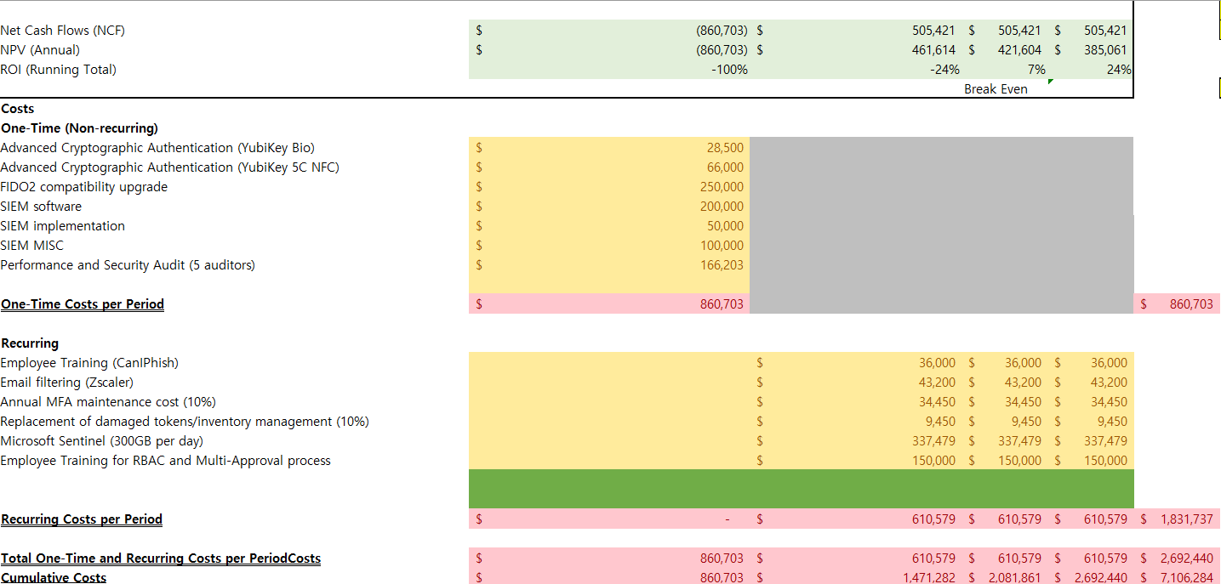
Financial Calculations

Slide 20
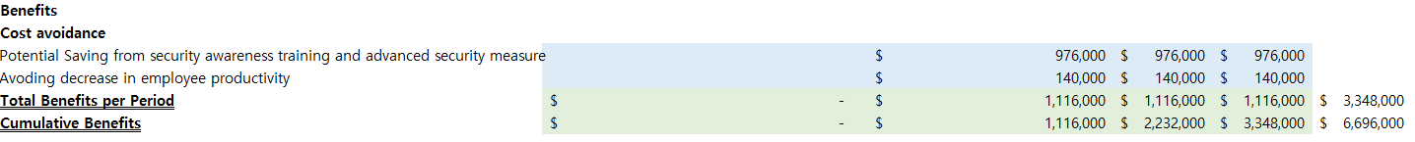
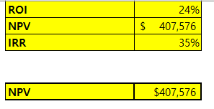
Financial Calculations

Slide 21
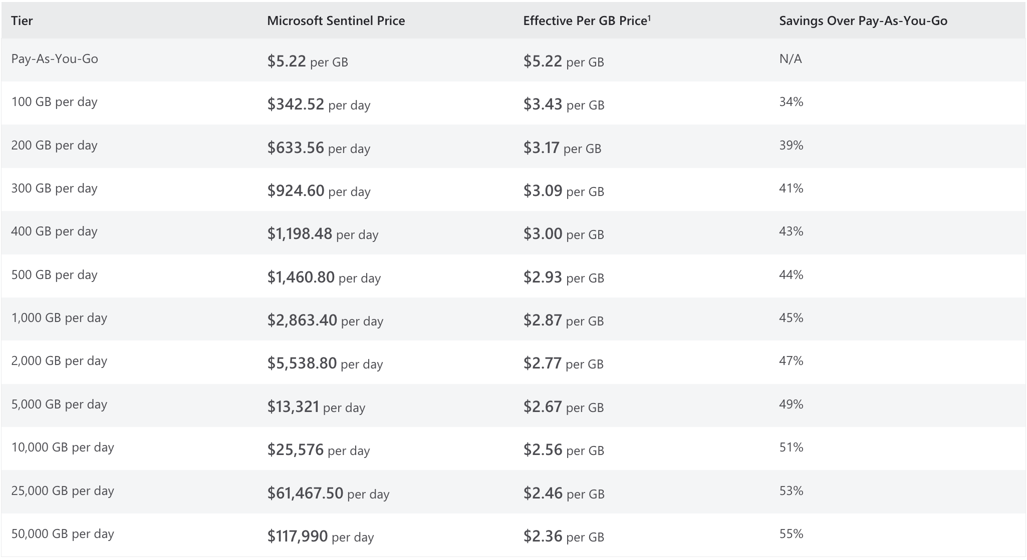
Microsoft Sentinel Pricing
5-10 people to manage and monitor the system
Source: https://azure.microsoft.com/en-us/pricing/details/microsoft-sentinel/

Slide 22
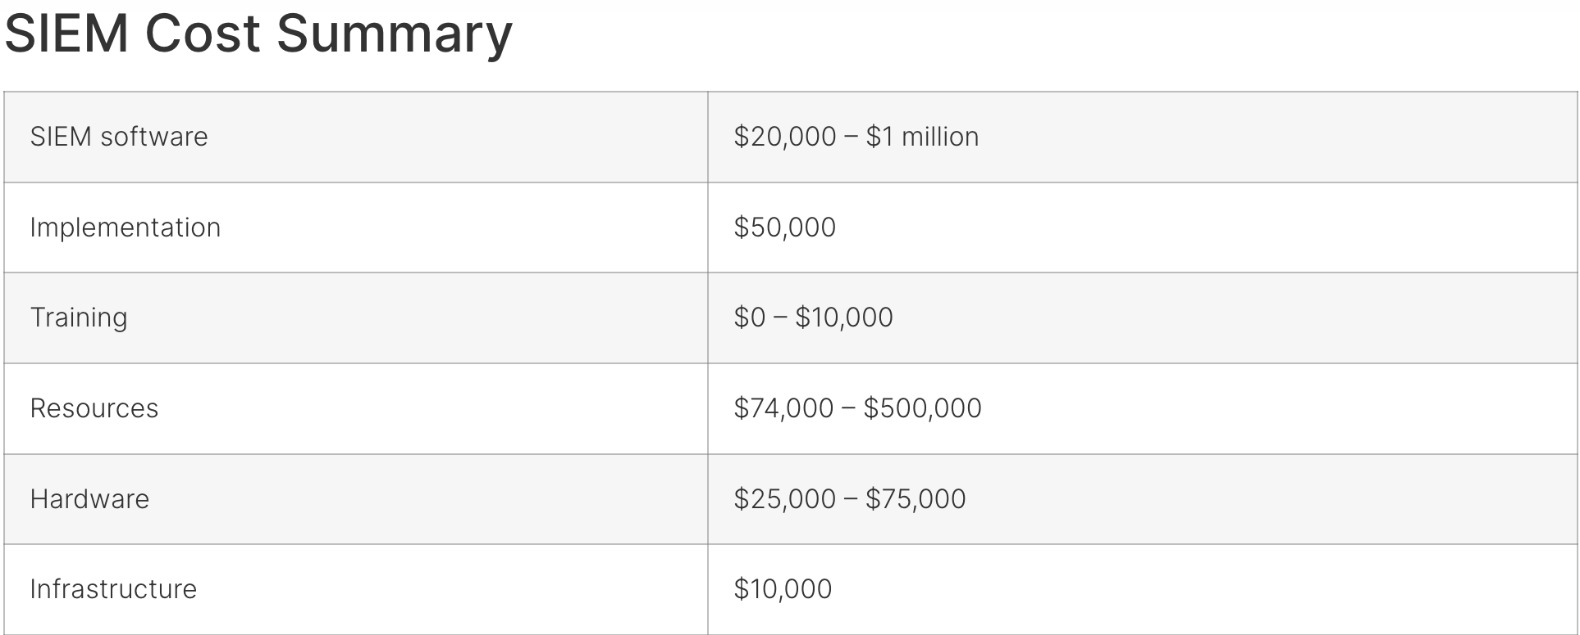
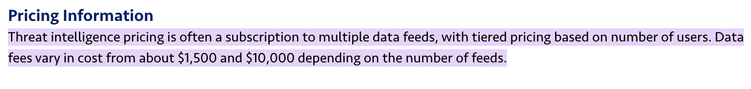
Centralized SIEM Platform and Pricing
Source: https://www.buchanan.com/managed-siem-pricing/
Source: https://www.trustradius.com/threat-intelligence#:~:text=Threat%20intelligence%20pricing%20is%20often,on%20the%20number%20of%20feeds.

Slide 23
Extended Risks and Mitigations
Risk | Degree | Mitigation Strategy
High Costs and Resource Demands of Cryptographic Infrastructure |  | Conduct a cost-benefit analysis to validate ongoing investment in MFA infrastructure. Prioritize high-risk accounts for cryptographic authentication, while utilizing lower-cost MFA options for less critical accounts
Increased System Complexity from Web Filtering and DNS Security |  | Pilot the web filtering solution in a test environment to identify potential application conflicts. Implement a process for quickly whitelisting business-critical sites, and regularly review blocked content to ensure business needs are not hindered
False Positives in Behavioral Anomaly Detection |  | Fine-tune UEBA thresholds and establish a feedback loop with security teams to refine detection criteria. Consider using machine learning algorithms that adapt and reduce false positives over time, increasing the accuracy of threat detection
Severity
Probability
Severity
Probability
Severity
Probability
Notes:
Anirban

Slide 24
Considerations and Issue Tree
Why did Teamviewer have a cyber breach?
Lack of employee training
Insufficient IAM
Lack of monitoring & controls
Weak Multi-Factor Authentication
Easy/Weak Password requirement
Lack of Segregation of Duties
Past breach not detected
Phishing
Lack of sense in security procedures
Opening unknown E-mail, link, file
Lack of least privileges measures
Leaked password from the last security incident
Using same password on public websites
Simple SSO (Yes or No)
No bio-scanning MFA
Hard cracked password combination
Easy-to-guess password (birthdate/name)

Slide 25
Sources Used
Midnight Blizzard. (2024). Midnight Blizzard escalates spear-phishing attacks. Link: Midnight Blizzard Escalates Spear-Phishing Attacks
SolarWinds. (2024). What is Remote Desktop Protocol (RDP)? Austin, TX: SolarWinds. Link: What Is Remote Desktop Protocol (RDP)? - IT Glossary | SolarWinds
SOCRadar® Cyber Intelligence Inc. (2023). APT profile: Cozy Bear / APT29. Ankara, Turkey: SOCRadar®. Link: APT Profile: Cozy Bear / APT29 - SOCRadar® Cyber Intelligence Inc.
MITRE ATT&CK®. (2017). APT29, IRON RITUAL, IRON HEMLOCK, NobleBaron, Dark Halo, NOBELIUM, UNC2452, YTTRIUM, The Dukes, Cozy Bear, CozyDuke, SolarStorm, Blue Kitsune, UNC3524, Midnight Blizzard, Group G0016. McLean, VA: MITRE Corporation. Link: APT29, IRON RITUAL, IRON HEMLOCK, NobleBaron, Dark Halo, NOBELIUM, UNC2452, YTTRIUM, The Dukes, Cozy Bear, CozyDuke, SolarStorm, Blue Kitsune, UNC3524, Midnight Blizzard, Group G0016 | MITRE ATT&CK®
FIDO Alliance. (2024). FIDO2. Mountain View, CA: FIDO Alliance. Link: FIDO2 - FIDO Alliance
Microsoft. (2024). Microsoft Entra passwordless sign-in - Microsoft Entra ID. Redmond, WA: Microsoft Corporation. Link: Microsoft Entra passwordless sign-in - Microsoft Entra ID | Microsoft Learn

Slide 26
Sources Used (Extended)
SANS Institute. (2024). Security awareness training. Bethesda, MD: SANS Institute. Link: https://www.sans.org/security-awareness-training/​SANS Institute
MITRE. (2019). User training, mitigation M1017 - Enterprise. Bedford, MA: MITRE Corporation. Liink: https://attack.mitre.org/mitigations/M1017/
MITRE. (2022). Multi-factor authentication request generation, technique T1621 - Enterprise. Bedford, MA: MITRE Corporation. Link: https://attack.mitre.org/techniques/T1621/
MITRE. (2017). Multi-factor authentication interception, technique T1111 - Enterprise. Bedford, MA: MITRE Corporation. Link: https://attack.mitre.org/techniques/T1111/
MITRE. (2020). Phishing: Spearphishing attachment, sub-technique T1566.001 - Enterprise. Bedford, MA: MITRE Corporation. Link: https://attack.mitre.org/techniques/T1566/001/
Cost of Capital. (2024). Link: https://pages.stern.nyu.edu/~adamodar/New_Home_Page/datafile/wacc.html

